Slide 1

EMPLOYEE ONBOARDING OPTIMIZER
Streamline & Enhance Your Employee Onboarding Experience
Presented By :
Sai Preethi M
Revathi K
R P Girish
M Rahul

Slide 2
CONTENTS
Problem Statement
Abstract
Objectives
Source Code
Conclusion
Presentation Title

Slide 3

PROBLEM STATEMENT
Employee Onboarding Optimizer helps manage new hires, onboarding processes, and feedback efficiently. It allows companies to personalize onboarding plans based on each employee’s background and needs. Additionally, it collects feedback to continuously improve the onboarding experience.

Slide 4
ABSTRACT
The Employee Onboarding Optimizer streamlines the onboarding process by managing employee records, tracking steps, and collecting feedback. It allows companies to personalize onboarding plans for each new hire and continuously improve the process. This ensures a smooth and efficient experience for both employees and organizations.

Slide 5


Sqlite3
Creates and manages the onboarding database (CRUD operations).
Matplotlib.pyplot
Visualizes onboarding feedback using a histogram.
MODULeS
USED

Slide 6
OBJECTIVES
Employee Management (CRUD Operations)
Personalized Onboarding Process
Feedback Collection
User-Friendly Menu
Data Visualization

Slide 7
SYSTEM ARCHITECTURE
FRONTEND
BACKEND
HTML, CSS, JS
User interacts with the onboarding system (Add Employee, Personalize Onboarding, Gather
Feedback).Calls REST API to communicate with the backend.
PYTHON(FLASK), JSON
Processes API requests from the frontend.
Performs CRUD operations.
Implements business logic for onboarding personalization and feedback collection.

Slide 8
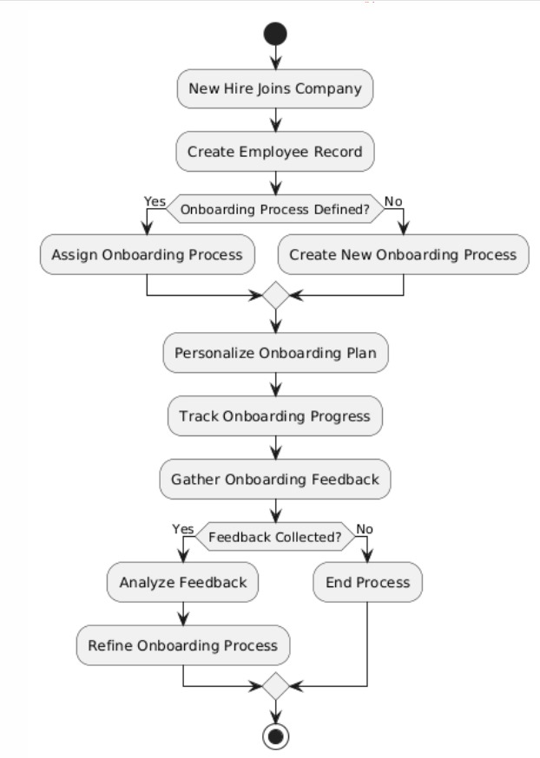
FLOWCHART

Slide 9
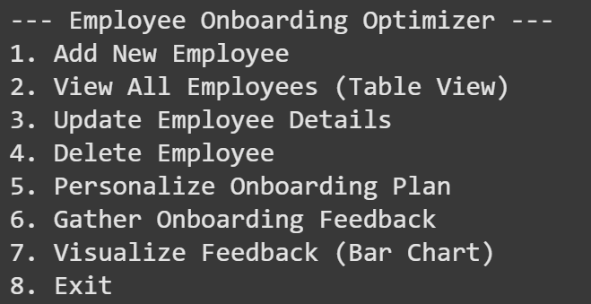
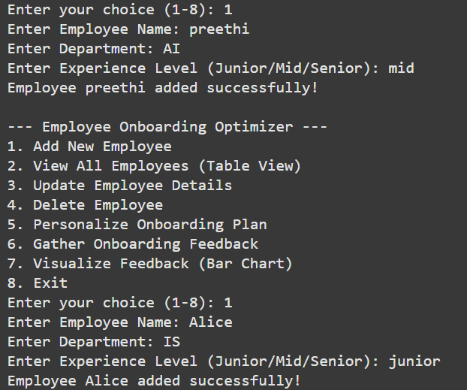
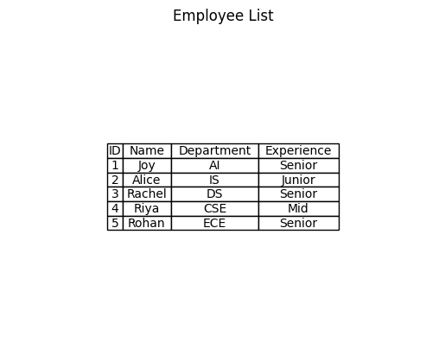
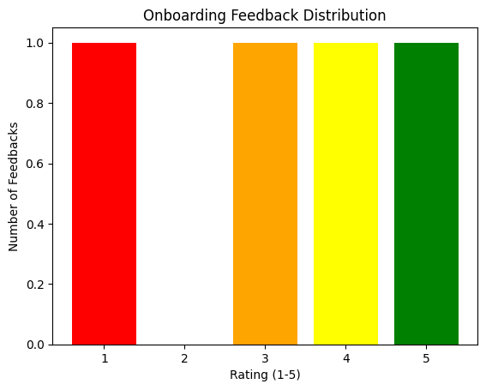
RESULT

Slide 10
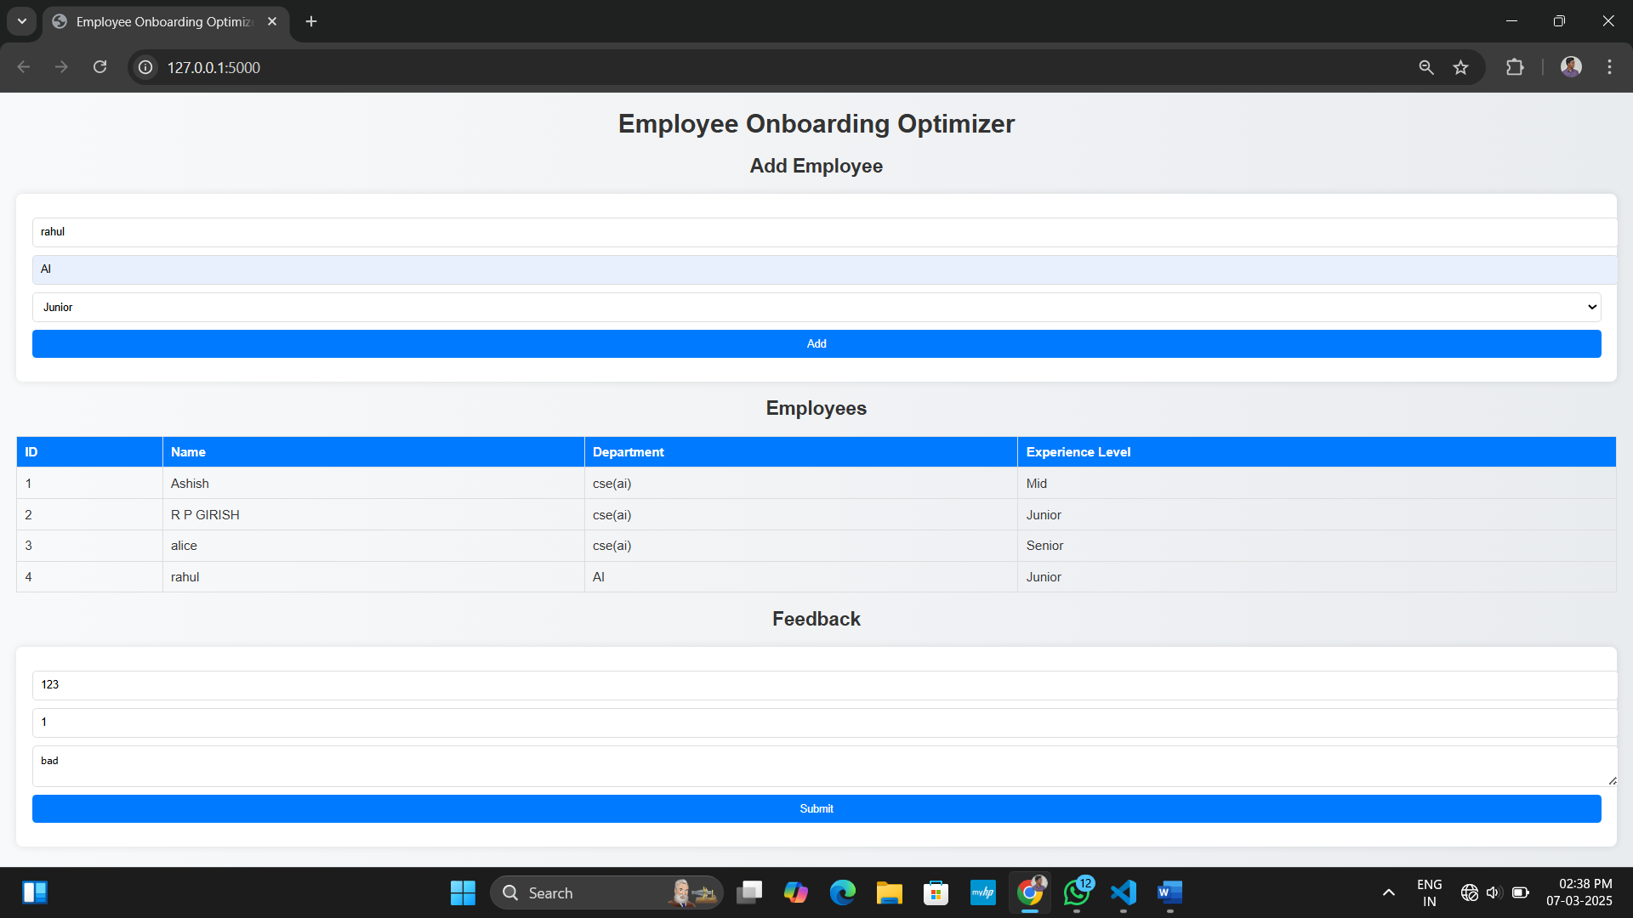

Slide 11


CONCLUSION
The Employee Onboarding Optimizer streamlines the onboarding experience by enabling CRUD operations on new hires, processes, and feedback while offering personalized onboarding plans based on individual employee needs. By continuously gathering and analyzing feedback, it ensures an adaptive and efficient onboarding process for long-term improvement.

Slide 12




THANK YOU

